Slide 1
Optimization
Metropolis Monte carlo
Line-search
PSO
Bassin Hopping

Slide 2
Outline
Goal: Understand typical optimization problems & usages
Focus on finding lowest energy structures
Methods for solving optimization problems
Discuss their workings & limitations

Slide 3
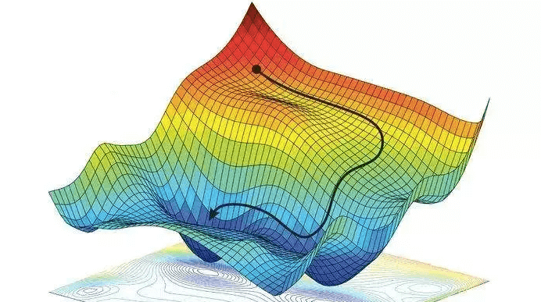
The optimization problem
Finding best solution → Minimizing some loss in terms of some paramters
Hard problem → Few cases analytic
Doing gradient descent
Evaluation of gradient
Stuck
Search space

Slide 4

Find lowest energy structures
Collection of atoms in LennardJones
First method: Metropolis Montecarlo
$RND<min\left(1, \frac{p(x^{′})}{p(x)}\right)⁡$→ Boltzmann statistics
Temperature dependent

Slide 5
Find lowest energy structures
(Low Temperature)
A little slow
Can we do better?
Adjustable temperature
Proposal function
(High Temperature)

Slide 6
Find lowest energy structures
(Line-search)
Second method: Gradient based optimization
Line-search → Stuck
Solution: Bassin Hopping or Random structure search
(Bassin Hopping)

Slide 7
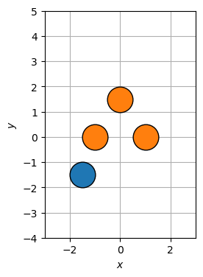
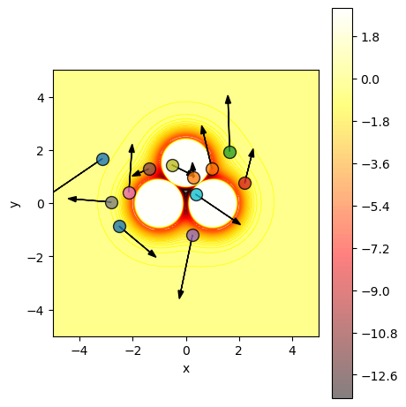
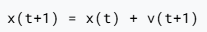

Another approach: Exercise 16 – PSO
Particle Swarm Optimization
Each particle →Atomic configuration
Update particle positions and velocities:

Slide 8
Another approach: Exercise 16 – PSO

Slide 9
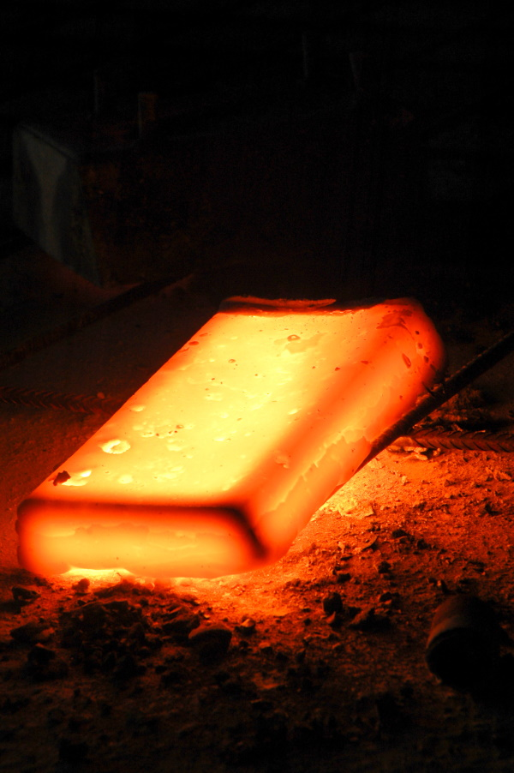
Yet another approach: Exercise 28 – Simulated annealing
Real world → Use MD-simulation
Set up relaxed atoms → Heat up → Cool down (slowly)
Hopefully end up in more stable structure

Slide 10
Yet another approach: Exercise 28 – Simulated annealing
Set up relaxed atoms → Heat up → Cool down (slowly)
Hopefully end up in more stable structure

Slide 12
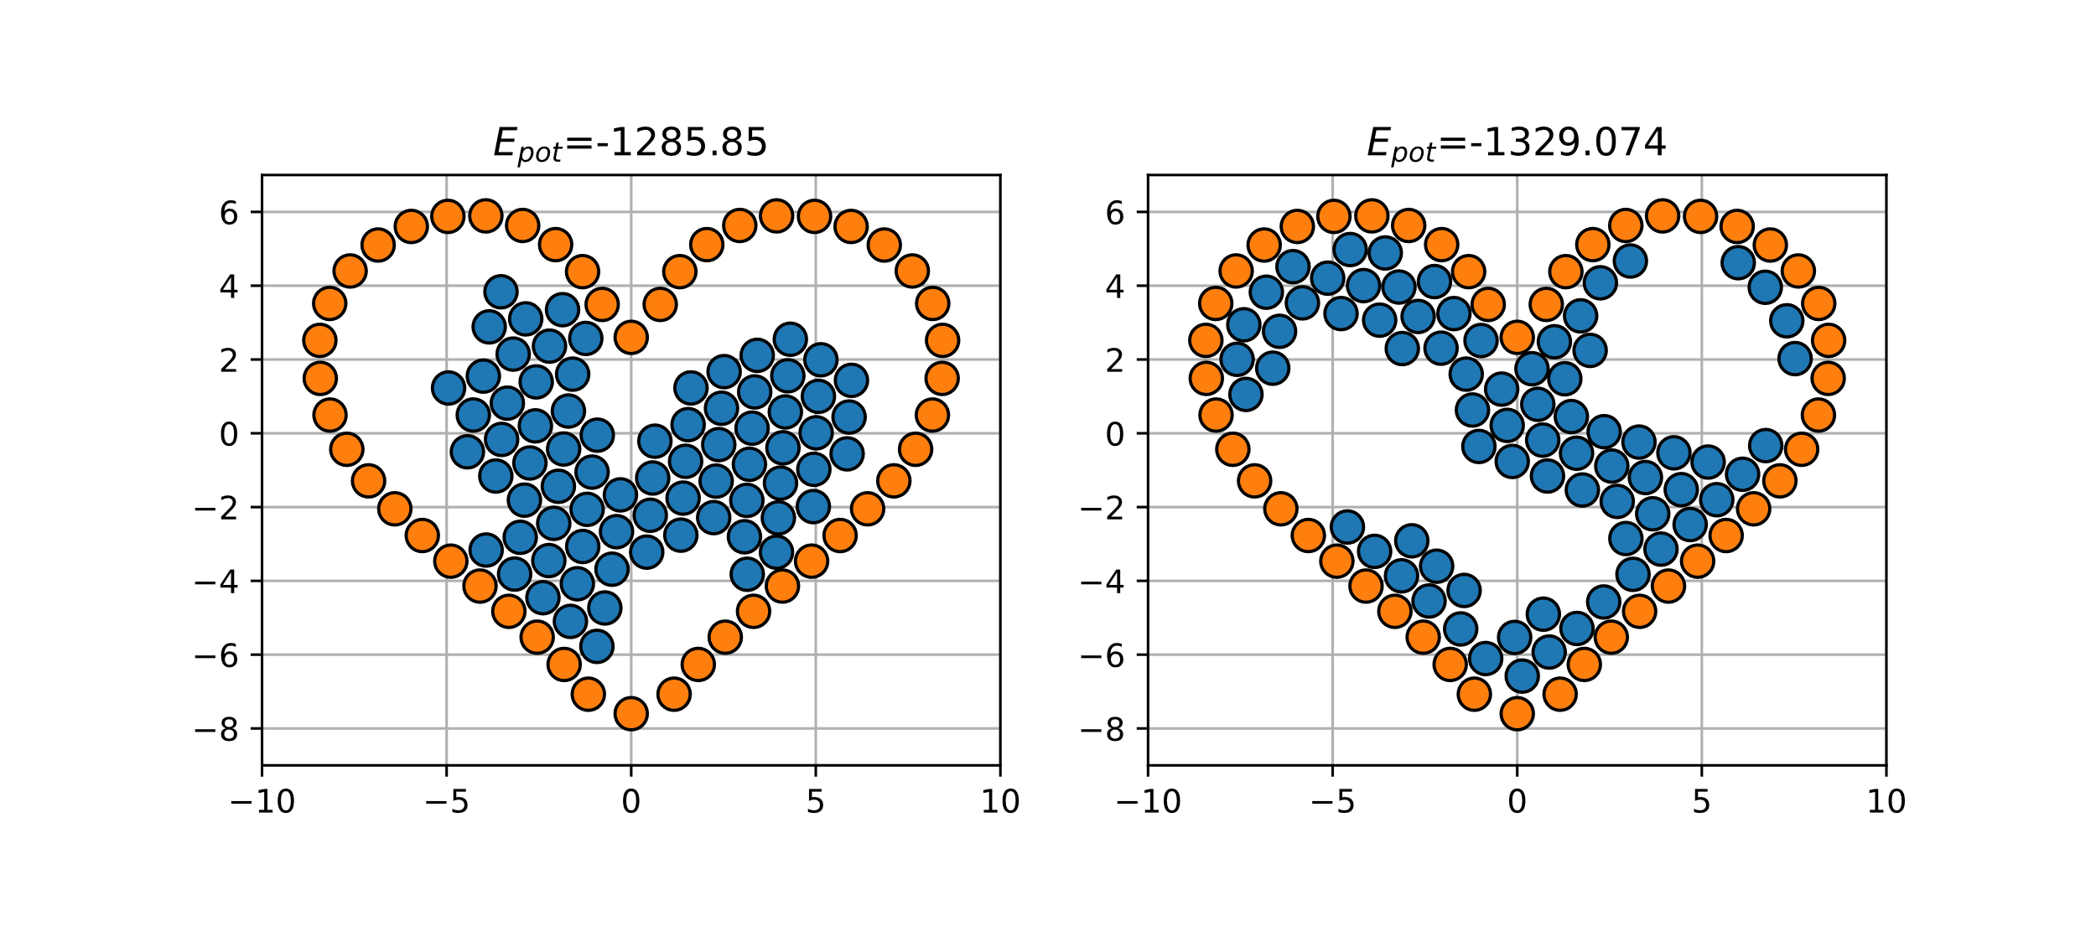
Exercise 28 – Simulated annealing
Finite simulation time

